Slide 1
Calculator
Using Python (Visual Studio Code)

Slide 2
About:
This project is a basic calculator application designed to perform fundamental arithmetic operations such as
addition, subtraction, multiplication, and division. It allows users to input numbers and select the desired
mathematical operation to quickly obtain accurate results.
The calculator is developed using the Python programming language, which is known for its simplicity and
readability. The project was created and executed in Visual Studio Code (VS Code), a powerful and widely
used source code editor that provides an efficient development environment.
The main objective of this project is to demonstrate the implementation of basic programming concepts such as:
User input handling
Conditional statements (if-else)
Arithmetic operators
Basic error handling
This project helps beginners understand how real-world applications are built using simple programming logic
and structured coding practices.

Slide 3
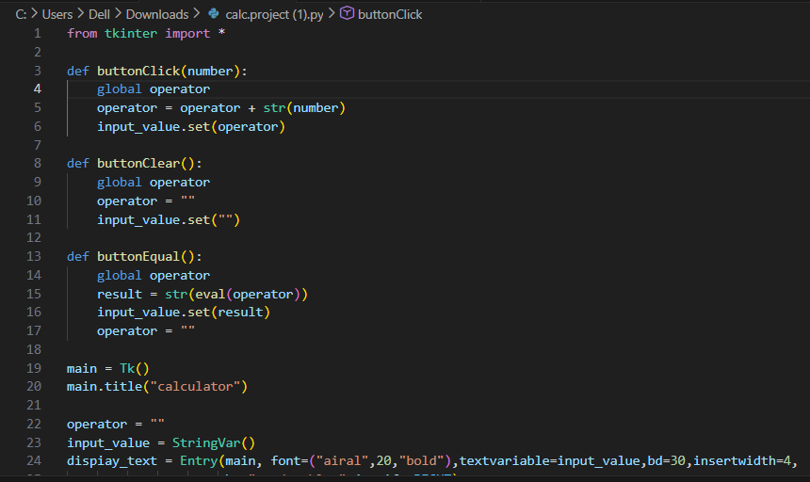
Here is script snap:

Slide 4
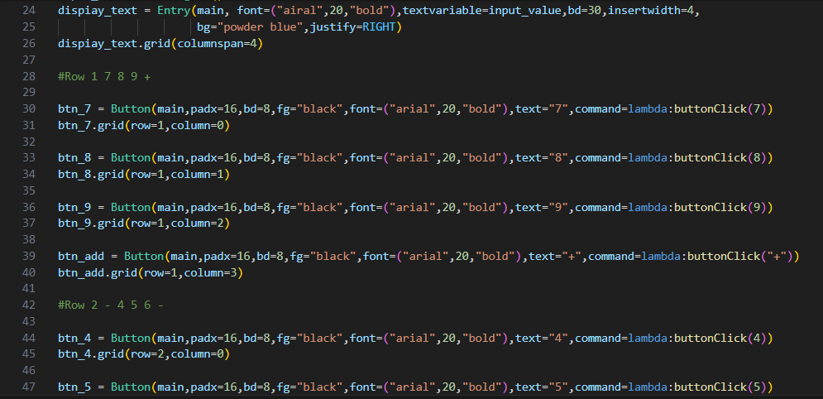

Slide 5
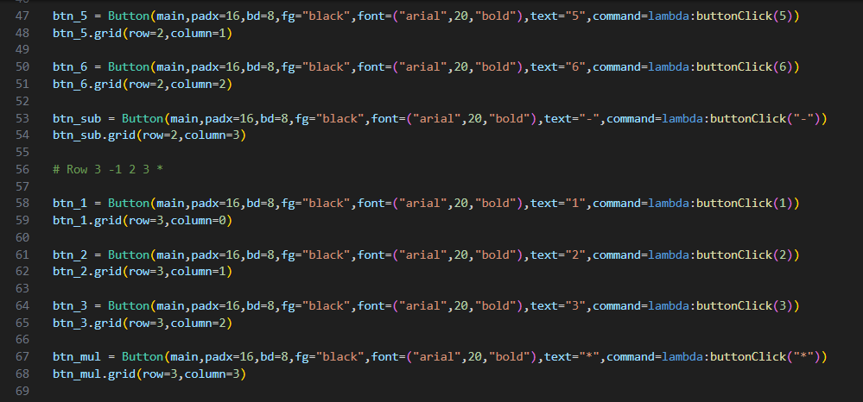

Slide 6
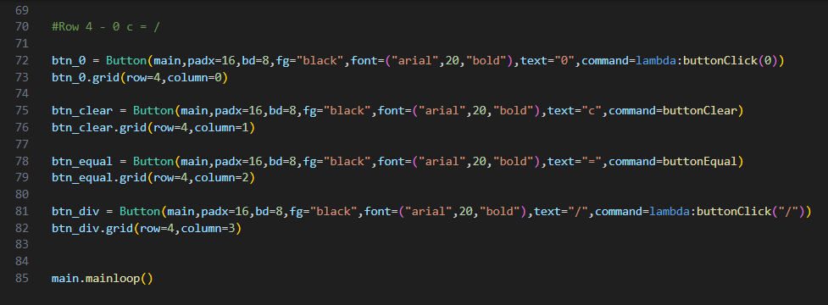

Slide 7
Thank you

